Slide 1

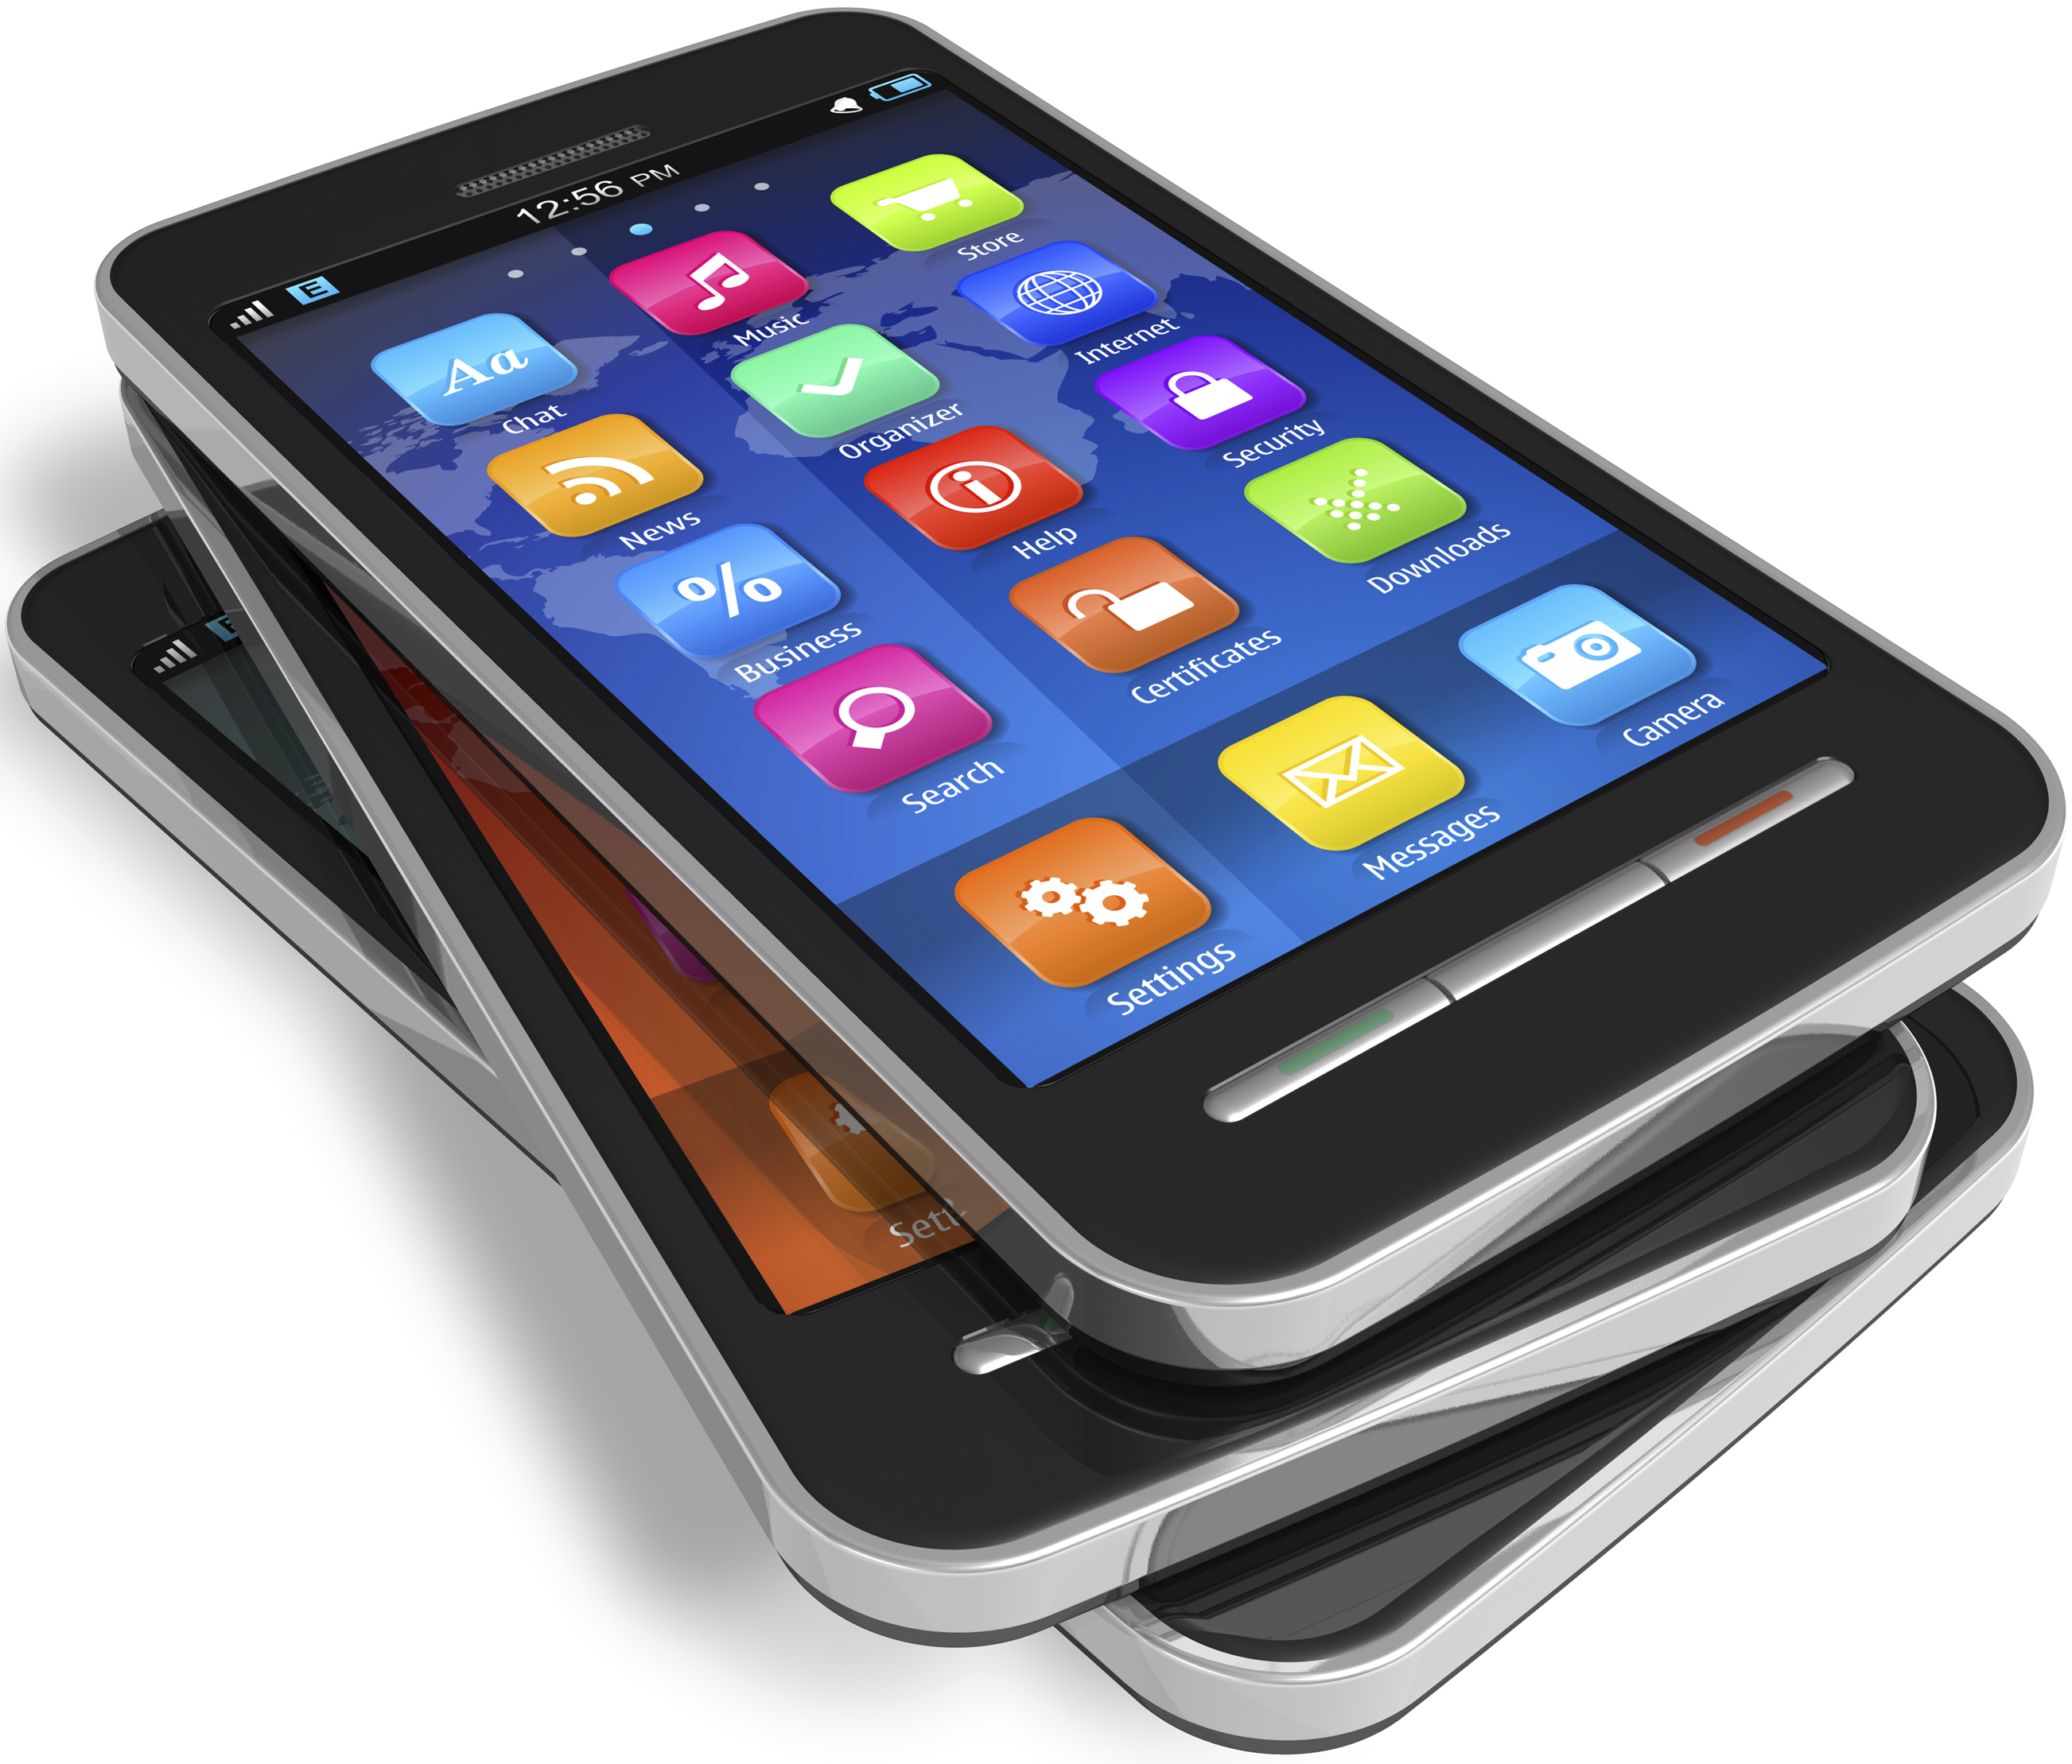
THE TOP TEN APPS
PewDiePie’s Simulator
Geometry Dash Lite
Domino’s Pizza USA
Egg, Inc.
ASOS
The Guardian
Cytus
Fernanfloo
Instagram
Clash of Clans

Slide 2
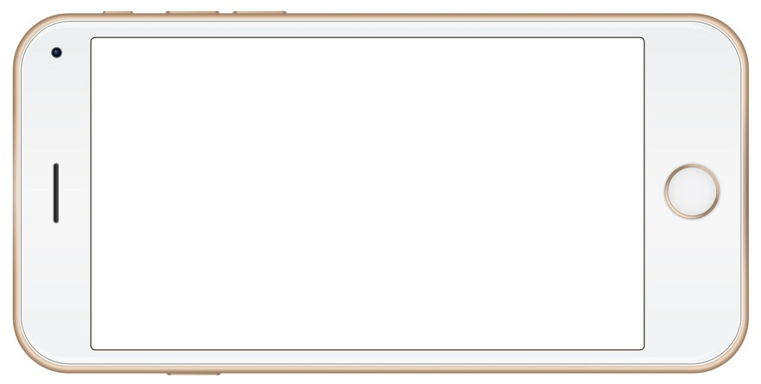
How Did We Find the Top 10?
Selected only Apps in both Google Play and Apple App stores.
Selected only apps with at least 5000 reviews in either store.
Lifespan of app based on average of rating of both stores.
One app in our recs costs > $1.

Slide 3




Avg. Rating in Half-Stars + 1 = App Lifespan in Years
$1500 Net Income per Month for 12 Months
$18,000
Per Year

Slide 4
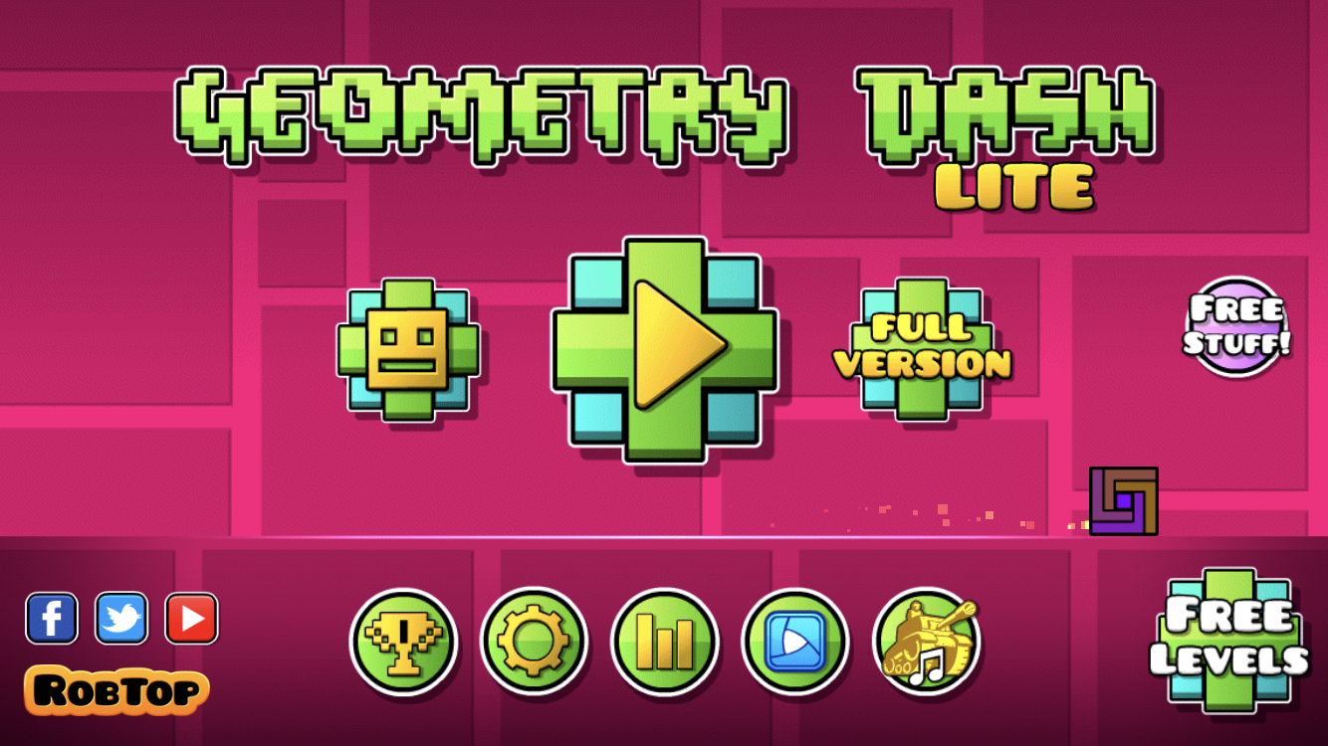
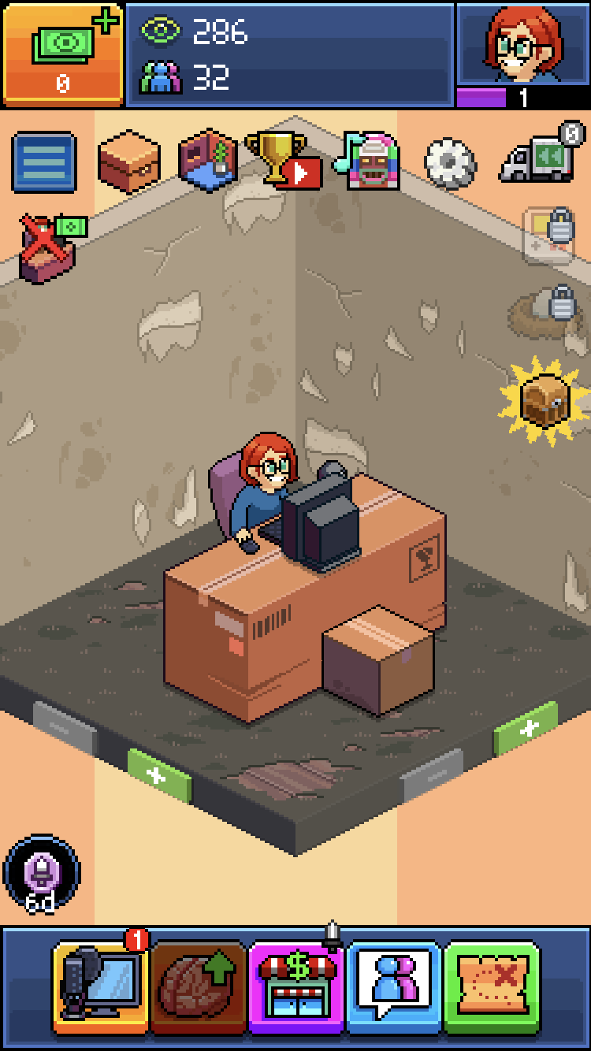
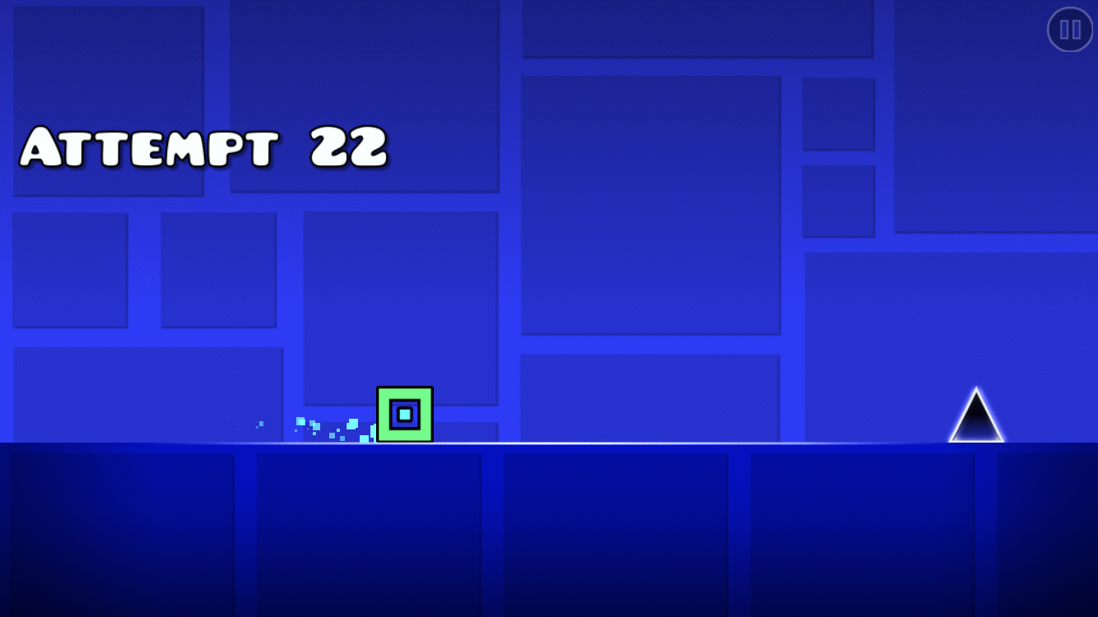
PEWDIEPIE’S TUBER SIMULATOR
-Most subscribed user on Youtube
-Reaches over 47 million users and has 13 billion views
-Vintage throw-back design appeals to wide audience
GEOMETRY DASH LITE
-Again with the classic side scroll and vintage design, coupled with much better graphics and speed making it accessible to all

Slide 5
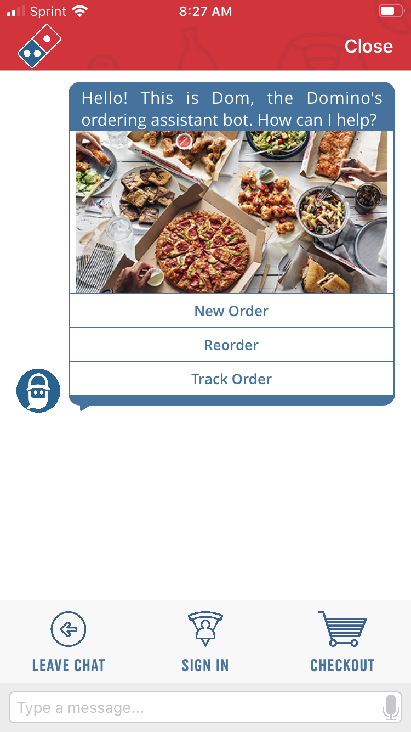
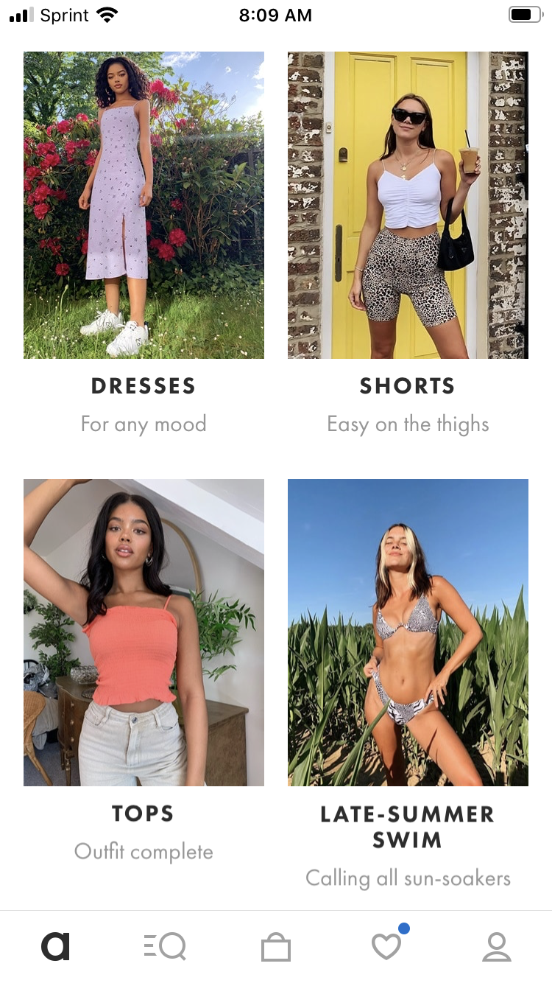
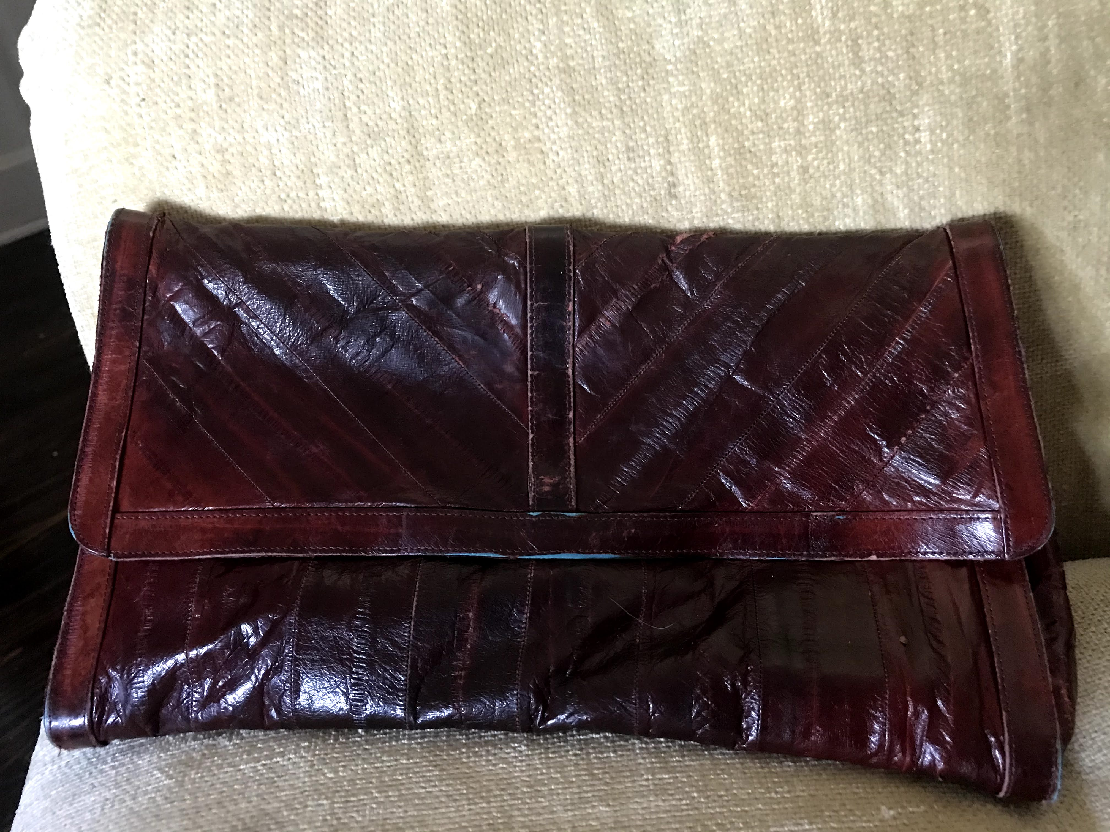
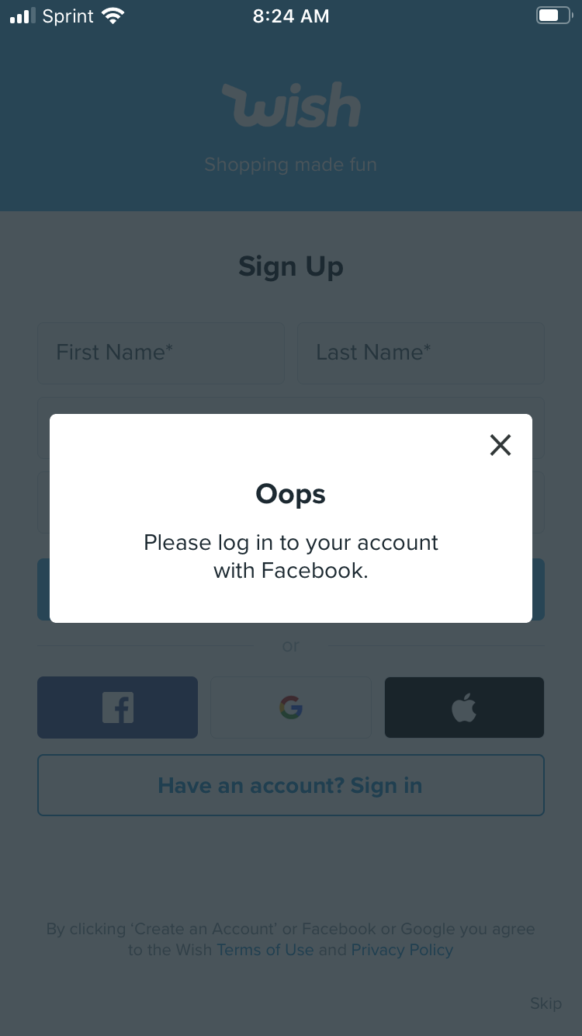
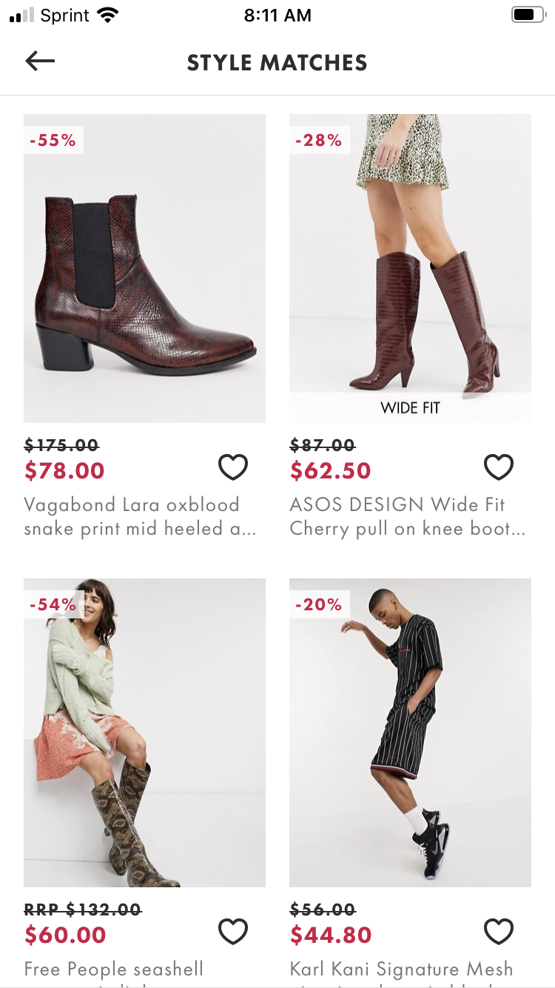
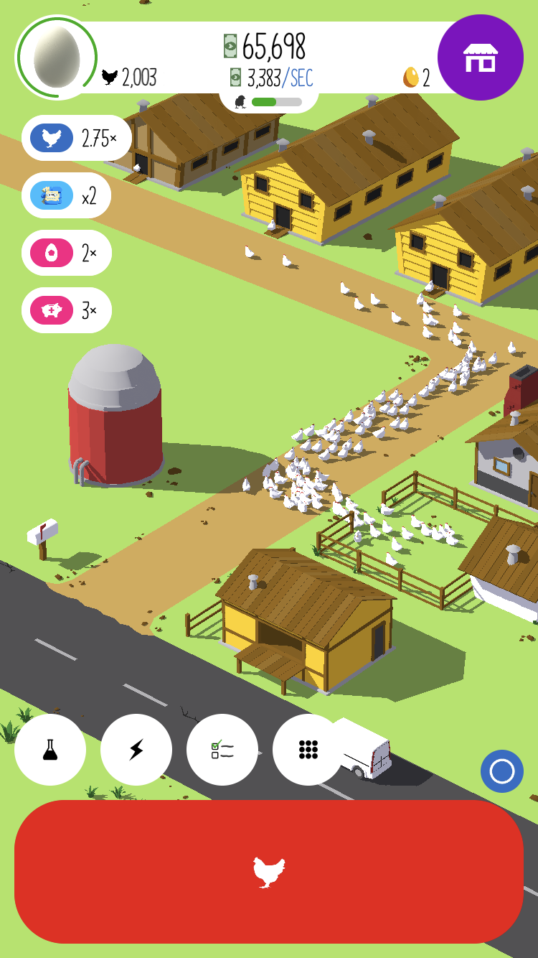
It’s Pizza, It’s Domino’s.
Nostalgia is in and it brought its new best friend to help: Dombot.
Egg, Inc.
-Popular Simulation style Idle Game
-Additional educational factor
ASOS
-No accounts required, more appeal
-International appeal
-Ethical Practices
-Style Match Cam

Slide 6

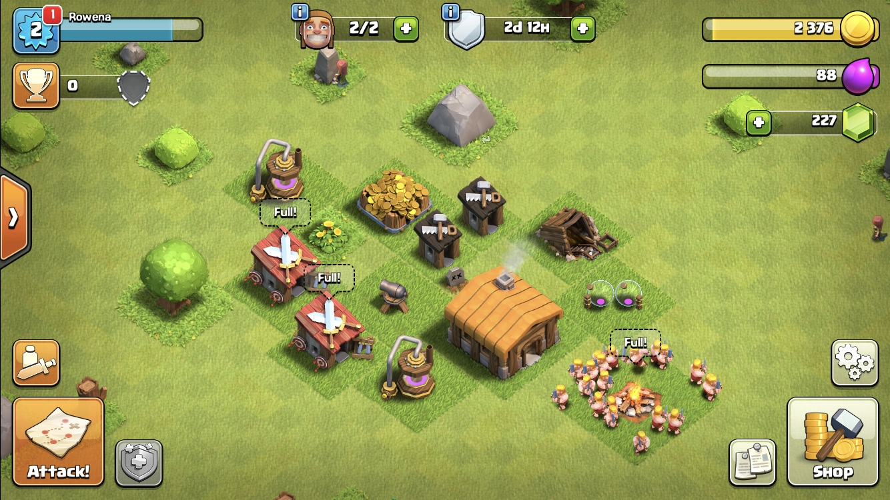
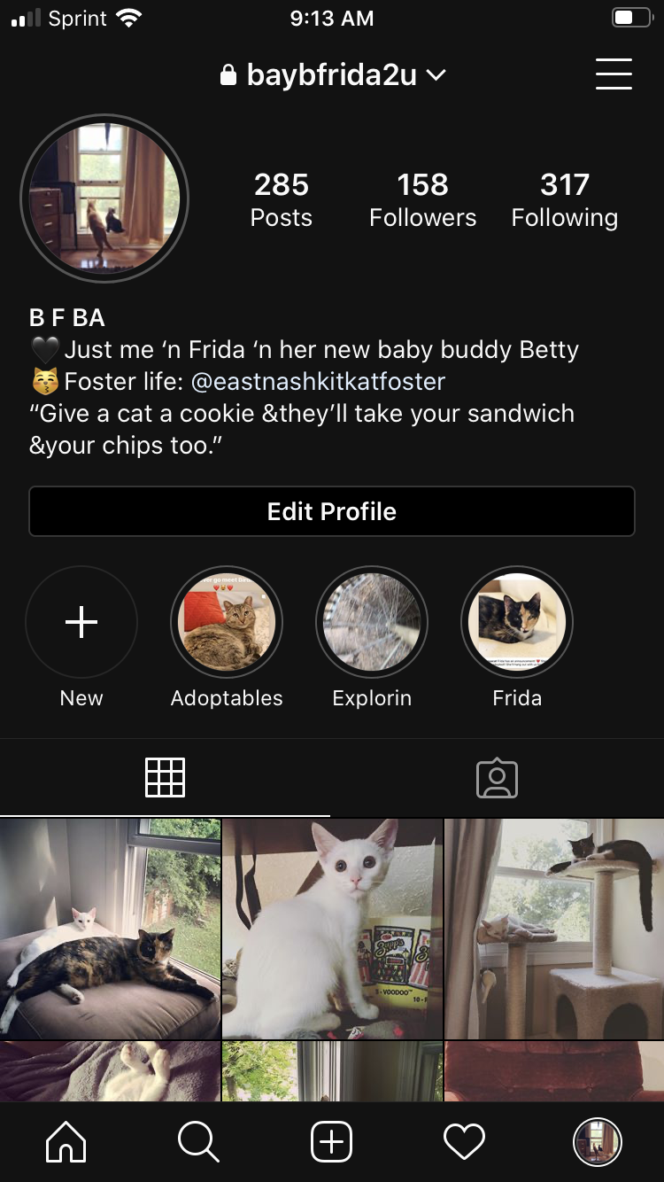

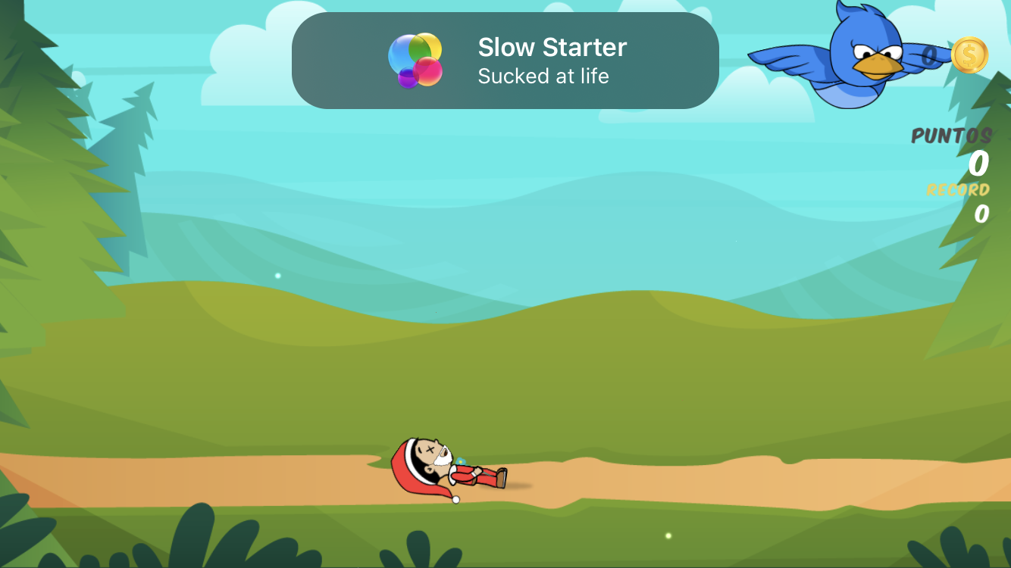

Slide 10



Slide 11
Absurdly Priced Apps – Could These Ever Work for App Trader? (Spoiler: No)
Price | Name | Rating | Review Count | Clout
$399.99 | I am rich | 3.8 | 3547 | 13479
$399.99 | I Am Rich Premium | 4.1 | 1867 | 7655
$0.00 | I AM RICH | 3.9 | 1455 | 5675
$399.99 | I am Rich Plus | 4 | 856 | 3424
$399.99 | ðŸ’Ž I'm rich | 3.8 | 718 | 2728
$18.99 | I am Rich Premium Plus | 4.6 | 459 | 2111
$399.99 | I am rich(premium) | 3.5 | 472 | 1652
$299.99 | I am rich VIP | 3.8 | 411 | 1562
$400.00 | I'm Rich - Trump Edition | 3.6 | 275 | 990
$399.99 | I Am Rich Pro | 4.4 | 201 | 884
$0.00 | i am rich | 3.9 | 213 | 831
$389.99 | I Am Rich | 3.6 | 217 | 781
$399.99 | I am Rich | 4.3 | 180 | 774
$37.99 | I am Rich Person | 4.2 | 134 | 563
$399.99 | I am rich (Most expensive app) | 4.1 | 129 | 529
$399.99 | I am Rich! | 3.8 | 93 | 353
$399.99 | I AM RICH PRO PLUS | 4 | 36 | 144

Slide 12
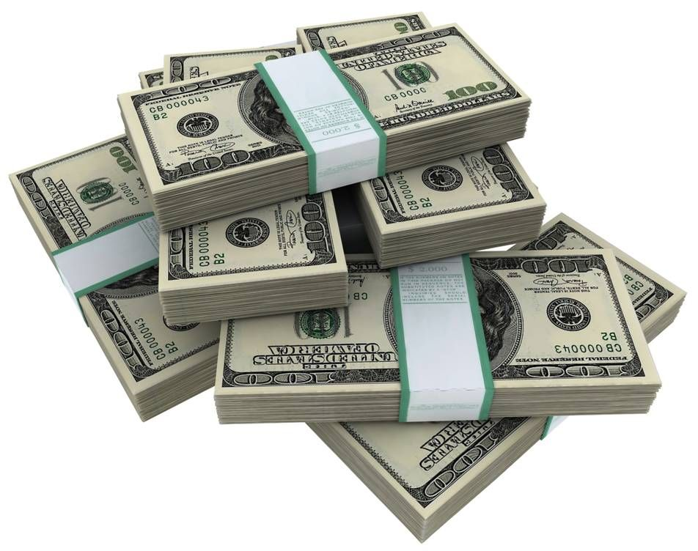
AGAIN, YOUR TOP TEN APPS
PewDiePie’s Simulator
Geometry Dash Lite
Domino’s Pizza USA
Egg, Inc.
ASOS
The Guardian
Cytus
Fernanfloo
Instagram
Clash of Clans

